Slide 1


Slide 2


DATA ARRANGEMENT

Slide 3
Directions to the questions 1- 5
Direction: Study the following information carefully to answer these questions. A, B, C, D, E, F and G are members of a sports club and have liking for different games, viz Carrom, Table Tennis, Badminton, Bridge, Hockey, Football and Lawn Tennis but not necessarily in the same order. Each one of them has a liking for different musical instruments, viz Sitar, Guitar, Harmonium, Flute, Tabla, Banjo and Santoor, not necessarily in the same order. B likes Carrom and Banjo. E likes to play Bridge but not Harmonium or Tabla. The one who plays Hockey plays Sitar. F plays Guitar but not Table Tennis or Lawn Tennis. A plays badminton and Flute. The one who plays Lawn Tennis does not play Tabla. C plays Harmonium and G plays Hockey.

Slide 4
Question: 01
D plays which game ?
Table Tennis
Lawn Tennis
Football
None of these
Answer: A

Slide 5
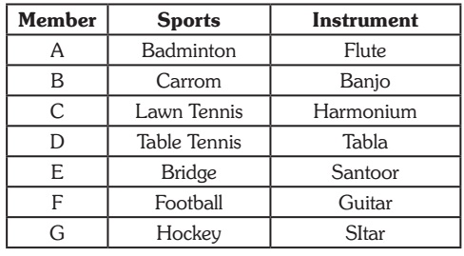
Explanation: 01

Slide 6
Question: 02
Who plays Santoor ?
D
A
E
D OR E
Answer: C

Slide 7
Explanation: 02

Slide 8
Question: 03
Which of the following combinations of gameperson-musical instrument is definitely correct?
Badminton-B-Flute
Table Tennis-E-Santoor
Lawn Tennis-D-Tabla
D. None of these
Answer: D

Slide 9
Explanation: 03

Slide 10
Question: 04
Who plays Football?
C
D
G
F
Answer: D

Slide 11
Explanation: 04

Slide 12
Question: 05
Who plays Table Tennis?
C
F
D
A
Answer: C

Slide 13
Explanation: 05

Slide 14
Directions to the questions 6- 10
Direction: Study the following information carefully and answer these questions. P, Q, R, S, T, W and Z are seven students studying in three different institutes – A, B and C. There are three girls among the seven students who study in each of the three institutes. Two of the seven students study BCA, two study medicine and one each studies Aviation Technology, Journalism and MBA. R studies in the same college as P, who studies MBA in college B. No girl studies Journalism or MBA. T studies BCA in college A and his brother W studies Aviation Technology in college C. S studies Journalism in the same college as Q. Neither R nor Z studies BCA. The girl who studies BCA does not study in college C.

Slide 15
Question: 06
In which college does Q study ?
A
C
B
D. D
Answer: A

Slide 16
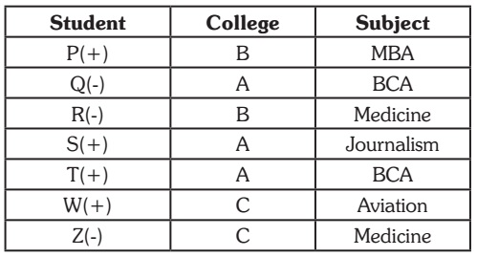
Explanation: 06

Slide 17
Question: 07
What is the field of study of Z ?
Aviation Technology
BCA
MBA
D. Medicine
Answer: D

Slide 18
Explanation: : 07

Slide 19
Question: 08
Which of the following three represents girls ?
SQR
QRZ
SQZ
None of these
Answer: B

Slide 20
Explanation : 08

Slide 21
Directions to the questions 9-12
Direction: Study the following information carefully and answer the questions given below. P, Q, R, S, T and M are six students of a school, one each studies in Class I – VI. Each of them has a favorite color from red, black, blue, yellow, pink and green, not necessarily in the same order. Q likes black and does not study in Class IV or V. the one who studies in Class IV does not like green. P studies in Class II. M likes blue and does not study in Class IV. The one who likes yellow studies in Class VI. S likes pink and studies in Class I. R does not study in Class VI.

Slide 22
Question: 09
In which class does R study?
V
III
IV
Data Inadequate
Answer: C

Slide 23
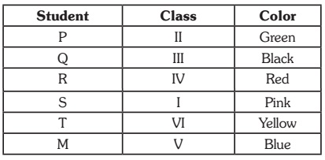
Explanation : 09

Slide 24
Question: 10
Which color does R like?
Black
Yellow
Green
None of these
Answer: D

Slide 25
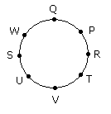
Explanation : 10

Slide 26
Question: 11
Which color does P like?
Green
Yellow
Red
None of these
Answer: A

Slide 27
Explanation : 11

Slide 28
Question: 12
Which of the following combinations is correct ?
P – II – Yellow
Q – III – Green
S – I – Black
Data inadequate.
Answer: D

Slide 29
Explanation : 12

Slide 30
Question: 13
Four houses Blue, Green, Red and Yellow are located in a row in the given order. Each of the houses is occupied by a person earning a fixed amount of a salary. The four persons are Paul, Krishna, Laxman, and Som. Read the following instruction carefully:
I. Paul lives between Som and Krishna II. Laxman does not stay in Blue house III. The person living in Red house earns more than that of person living
in Blue

Slide 31
Explanation : 13
IV. Salary of Som is more than that of Paul but lesser than that of Krishna V. One of the person earns ₹ 80, 000 VI. The person earning ₹ 110,000 is not Laxman VII. The salary difference between Laxman and Son is ₹ 30,000 VIII. The House in which Krishna lives is located between houses with persons earning salaries of 30,000 and ₹ 50,000 IX. Krishna does not live in Yellow house, and the person living in yellow house is not earning lowest salary among the four persons.

Slide 32
Question: 14
Who lives in Red house?
Paul
Krishna
Laxman
Son
Answer: B

Slide 33
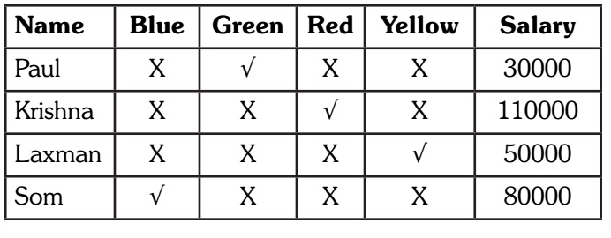
Explanation : 14

Slide 34
Question: 15
Which house is occupied by person earning highest salary ?
Blue
Green
Red
Yellow
Answer: B

Slide 35
Explanation : 15

